Slide 1
Kafka
Group 06
Mushafiq Fakki

Slide 2




Team Members:
Vamshi Krishna Nuka
Mushafiq Fakki
Ankit Prakash
Venkata Sai Krishna Dasari
Mushafiq Fakki

Slide 3
Agenda
What is Apache Kafka?
Why Kafka?
Kafka Architecture
What is Zookeeper?
Demo
Mushafiq Fakki

Slide 4
What is Apache Kafka?
Kafka is a distributed streaming platform.
It is a messaging system that receives data from different sources and make the data available to target system in real time.
Kafka is written in java and scala
Kafka was originally developed by at LinkedIn in 2011
Mushafiq Fakki

Slide 5
Unlike messaging platform, Kafka can handle trillions of events a day
Kafka is used heavily in the big data space as a reliable way to ingest and move large amounts of data very quickly
Mushafiq Fakki

Slide 6
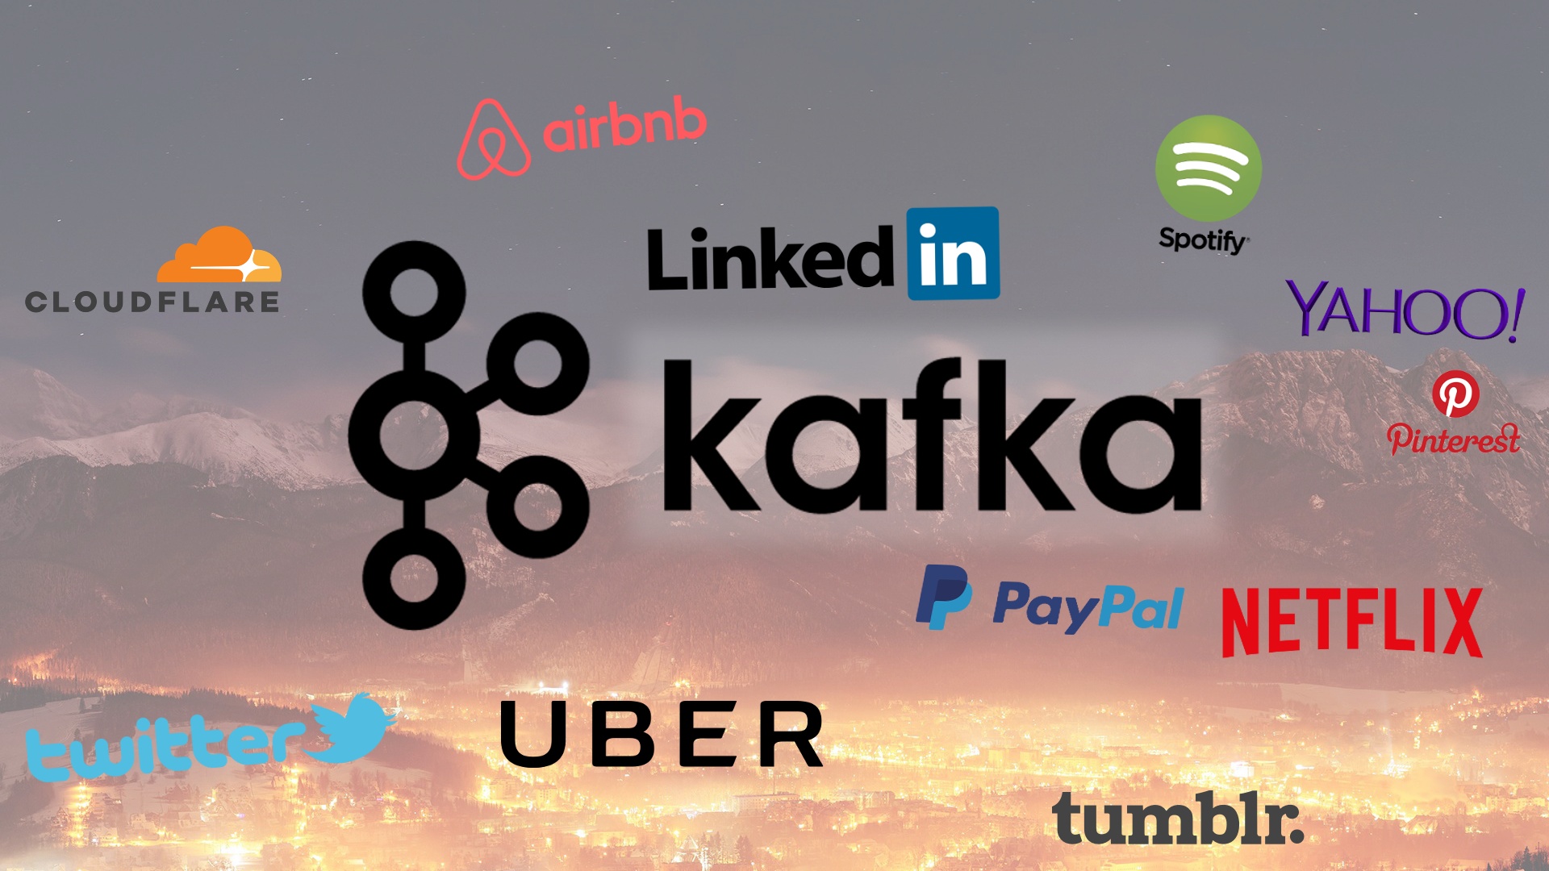

Slide 7
Kafka Terminology
Producer
Consumer
Broker
Cluster
Topic
Partitions
Offset
Consumer Groups
Venkata

Slide 8
Kafka Terminology
Producer - An application that sends messages to kafka.
Consumer - An application that reads the messages from kafka.
Requests for messages
Producer
messages
Kafka server
Consumer
messages
Venkata

Slide 9
Kafka Terminology
Broker - It is a meaning full name given to the kafka server.
Cluster - A group of computers sharing workload for a common purpose.
Requests for messages
messages
Cluster
Consumer
Producer
Broker
messages
Broker
Venkata

Slide 10
Kafka Terminology
Topic - A topic is a unique name given to the kafka stream.
Partitions - Topic is broken into chunks of data called partitions.
Offset - A sequence id given to messages as they arrive in a partitions.
Consumer Groups - A group of consumers acting as a single logical unit.
Venkata

Slide 11
Why Kafka?
Kafka provides low-latency, high-throughput, fault-tolerant
Kafka can work with Flume/Flafka, Spark Streaming, Storm, HBase, Flink, and Spark for real-time ingesting, analysis and processing of streaming data
Ankit

Slide 12
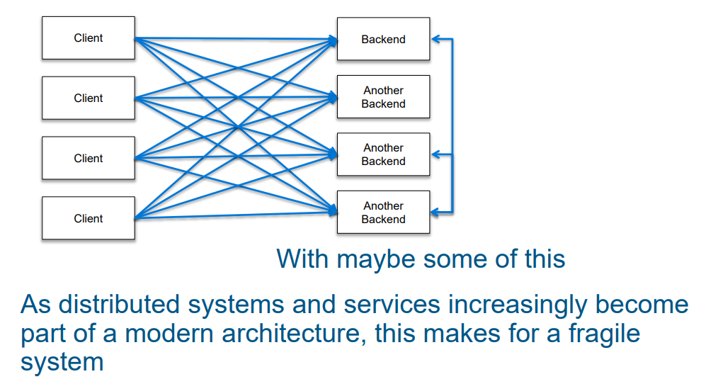
Ankit

Slide 13
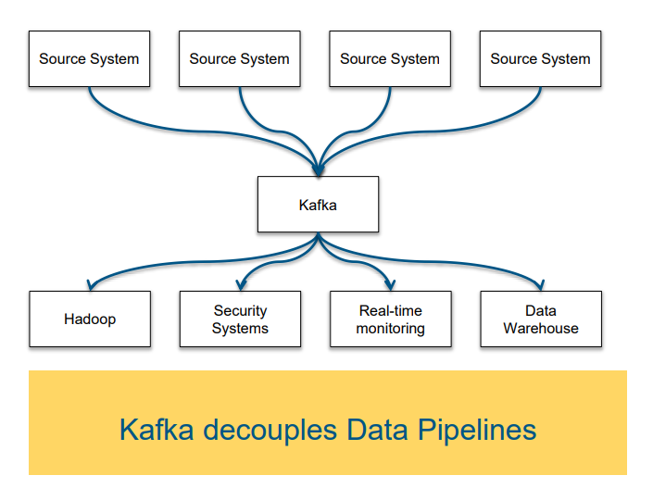
Producers
Broker
Consumers
Ankit

Slide 14
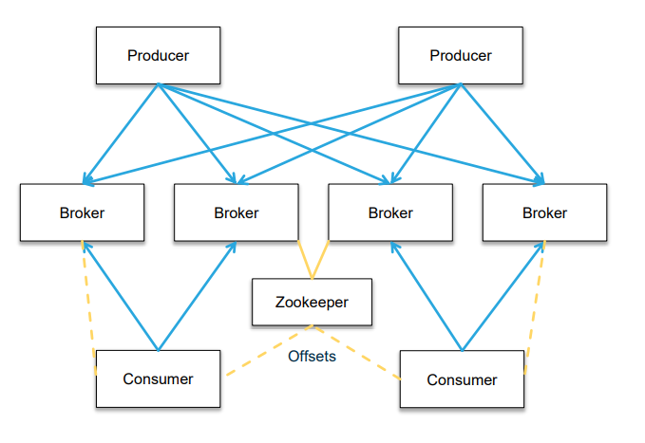
Architecture
Ankit

Slide 15
What is Zookeeper?
Zookeeper is a distributed key-value store.
It is highly-optimized for reads but writes are slower.
It is most commonly used to store metadata and handle the mechanics of clustering.
It allows clients of the service (the Kafka brokers) to subscribe and have changes sent to them once they happen.
Vamshi

Slide 16
Is Zookeeper Fault - tolerant?
Vamshi

Slide 17
Yes, Zookeeper is Fault-tolerant.
Kafka is fault-tolerant and it heavily depends on zookeeper.
So it is must for zookeeper to be fault-tolerant.
Zookeeper helps in maintaining information synchronized across the nodes in cluster.
Vamshi

Slide 18
DEMO
Ankit

Slide 19
References
https://www.confluent.io/what-is-apache-kafka/
https://techbeacon.com/app-dev-testing/what-apache-kafka-why-it-so-popular-should-you-use-it
https://www.youtube.com/watch?v=udnX21__SuU

Slide 20
Thank you
Any questions?

